Slide 1
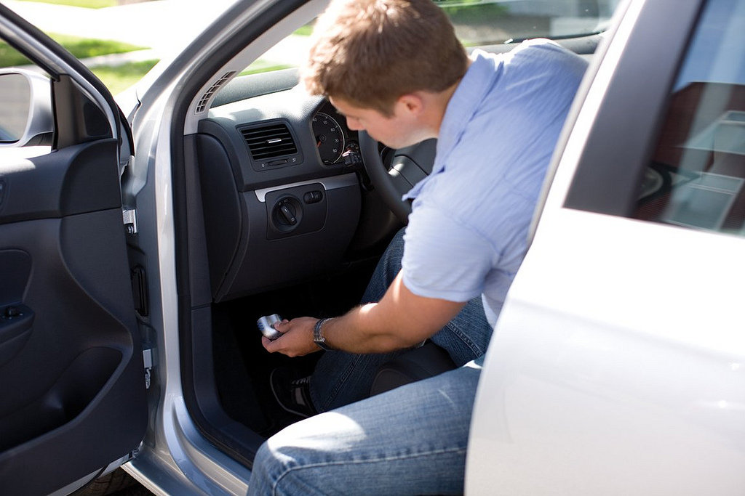
In-Vehicle Monitoring Technology

Slide 2
Overview:
What are in-vehicle monitoring technologies?
Functions and benefits
Attitudes and concerns
Future applications
Current initiatives

Slide 3
Definition:
In-vehicle monitoring technologies are designed to:
monitor, record, influence and provide feedback regarding the in-vehicle behaviour and environment of young drivers; and,
prevent risky driving behaviours in several ways.

Slide 4
How do they provide feedback?
Forcing:
Blocking unsafe behaviour (e.g., locking ignition until seatbelt is fastened).
Feedback:
Cues drivers to hazardous behaviours (e.g., speed limit alerts).
Reporting:
Records driver performance for parents and the young driver (e.g., GPS locator, acceleration gage, radar sensors).

Slide 5
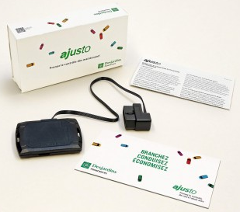
How common is in-vehicle monitoring technology?
Devices are most often used in research studies.
Only half of parents in the U.S. report awareness of this technology.
Some limitations include the cost of the device and the need for technical knowledge to install and use it.

Slide 6
Reducing risky behaviours among teen drivers
Studies of intervention programs have shown significant reductions (76%) in risky behaviours among young drivers using these technologies.
In-vehicle alerts improved seatbelt use for young drivers and decreased speeding slightly.

Slide 7
Other benefits for young drivers
Feedback is essential and important to increase learning and motivation in young drivers.
It helps to open a dialogue between parents and teen drivers about safe driving practices.
Parents and young drivers can better identify and target areas that may need improvement.

Slide 8
Parental attitudes, concerns, and perceptions
A U.S. survey revealed that all participating parents planned to monitor their teenager driver after licensure.
Only 1% of parents said that they would use in-vehicle technology to monitor their young drivers.
A majority reported that they trusted their teens and felt it was an invasion of privacy.

Slide 9
Teen attitudes, concerns, and perceptions
There is limited research that focuses on teens’ opinions of in-vehicle monitoring technologies.
Invasion of privacy seems to be the main issue with respect to these technologies.
Parents must be conscious of the importance of privacy and the effect it may have on the behaviour of young and new drivers.

Slide 10

How would in-vehicle technology affect graduated driver licensing programs?
A video recording device could provide ongoing supervision of teen drivers.
Devices can help condition good habits and improve driving habits in the long term.
Devices enable parents to ensure that their teen is adhering to GDL program requirements.

Slide 11
What else can parents do to help reduce the crash risk of young drivers?
Choose a vehicle that provides good crash protection.
The death rate per registered vehicles is twice as high for small cars as larger cars.
Choose a vehicle that has good safety features.
If cost is an issue, delaying vehicle ownership for teens may be a safer option.

Slide 12

In-vehicle technology initiatives
American Family Insurance
Teen Safe Driver Program gives members the option of installing an in-vehicle monitoring device in their young driver’s vehicle free of charge.
A study by the University of Maryland’s National Study Center for Trauma and EMS found that this reduced risky driving habits by more than 70% for the young driver, with a 50% decrease experienced immediately.

Slide 13
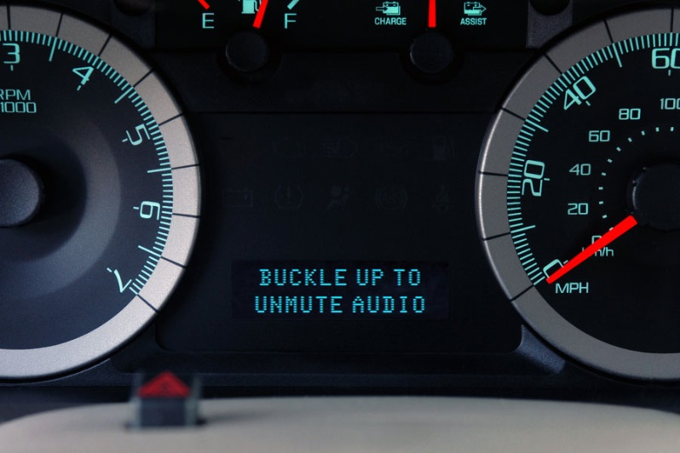
In-vehicle technology initiatives
Ford’s My Key
Limits speed for young drivers.
Mutes audio until seatbelts are buckled.
Early warnings lights (e.g., low fuel at 100km to empty instead of 30km).

Slide 14
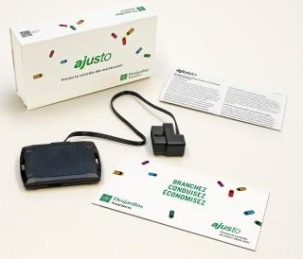
In-vehicle technology initiatives
Insurance programs with technologies that monitor:
time driving and time of day;
speed;
acceleration and harsh breaking;
mileage; and,
location (Insurance Bureau of Canada 2013).
Examples:
Ajusto Program- Desjardins Insurance
Snapshot- Progressive Insurance
Drive Wise- Allstate
Mobiliz- Industrial Alliance
In-Drive- State Farm

Slide 15
For more information, visit us at:
www.yndrc.ca
www.tirf.ca
Stay informed!

